Slide 1
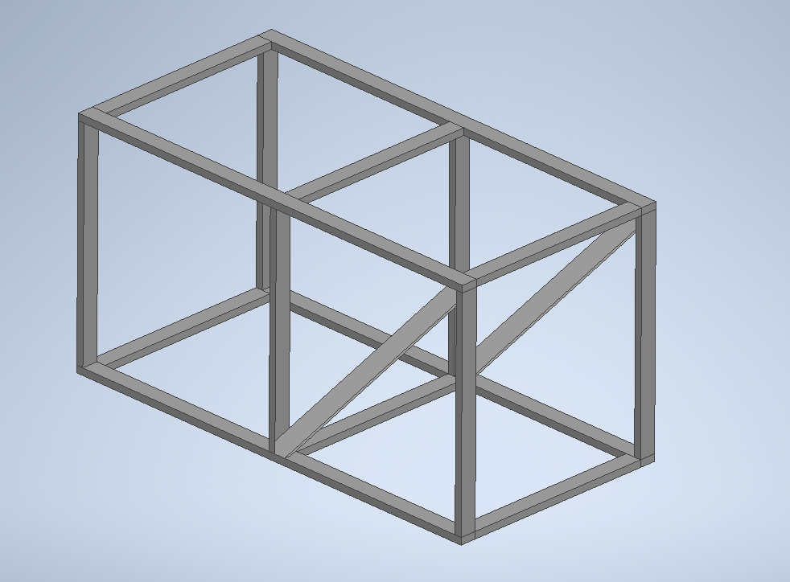
Front Foot x2
9 2x4x8
2 2x4x10

Slide 2
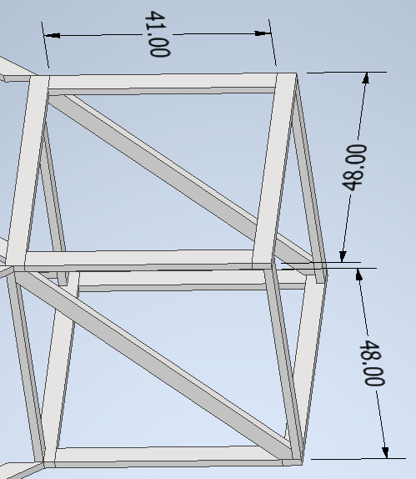
Front Foot
x2
(7) 2x4x8
(8) 48”
  2 from each of (4) 8’
(2) 41”
  2 from (1) 8’
(2) 41”
  1 from each of (2) 8’, save extra for:
(2) slants
  Use extra length from offcuts from 41”

Slide 3
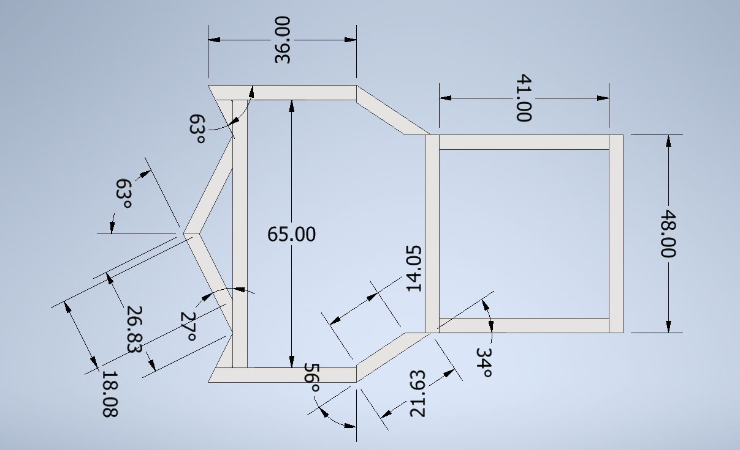
x2 (base and top)

Slide 4
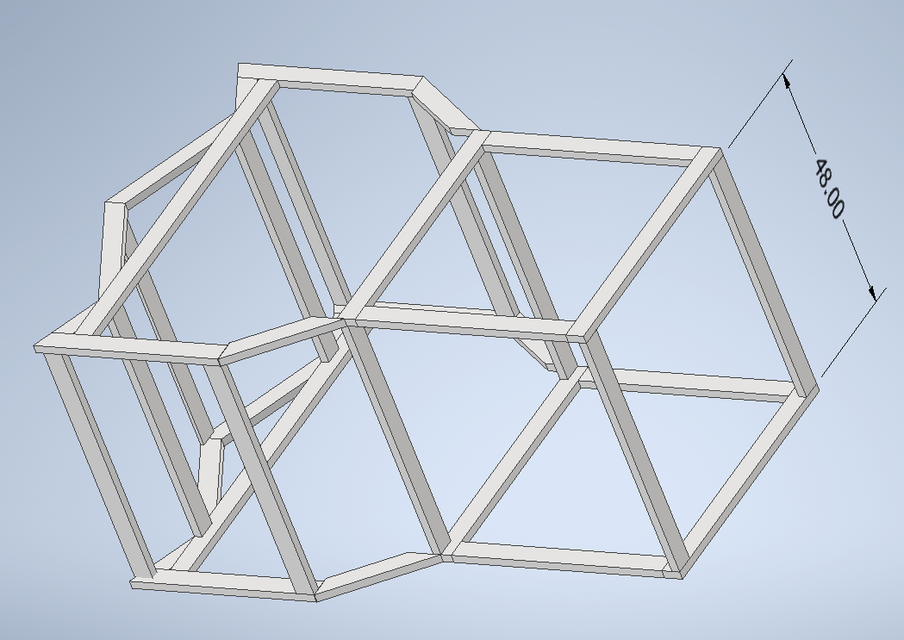
(2) 2x4x8
(11) 4’

